Slide 1
Capstone project
Provide itinerary to FunX Tours
With Data Science approach
By Brandon Chen

Slide 2
Introduction/Business problem
FunX Tours, a tour operating new startup in New York, faces a very competitive market.
Given its limited resources, FunX Tours wants to distinguish itself using data science.
FunX targets the 25 to 35 years olds as its main customers. It believes that with this group, data science is the most appropriate approach as they are heavy internet users.

Slide 3
Data description
Geographical data about neighborhoods in New York is readily available in http://geo.nyu.edu/catalog/nyu_2451_34572, this is a good starting point for us.
Foursquare API contains a comprehensive location data about many venue in New York, and we believe the database represents an up-to-date customers experience after visiting the venues.
FunX’s data requirement:
1 and 2 day tours are its focus, and tour activities concentrated in one neighborhood are preferred for time-consuming and easy transportation;
Venues for activities: 1. places of interest; 2. American restaurants; 3. Bars; 4. Shops

Slide 4
Methodology
I transformed the latitude and longitude data in http://geo.nyu.edu/catelo/ny_2451_34572 into data frame.
The geographic data in 1 contains a total of 5 boroughs and 306 neighborhoods. Given that FunX’s tour itinerary consists 1 or 2-day package, I will focus on exploring Manhattan.
I will utilize the Foursquare API to explore the neighborhoods in “Manhattan” only. I will get the top 100 venues that are in all neighborhoods in Manhattan within a radius of 500 meters.
I will use k-means to cluster the neighborhoods into 5 clusters. Using the results, I can then organize transportation and schedule given the proximity map generated by k-means.
I will rank Manhattan neighborhoods by 10 most common venues and organize our tour packages.

Slide 5
Results
I will try to pack all activities into 1-day tour as I give the tour customers a full and impressive day tours. FunX has given us its criteria for visiting venues: 1. Places of interest; 2. Restaurants for authentic American foods; 3. Bars or nightclubs; 4. Shops.
After careful examination of neighborhood data, I found that Midtown meets FunX’s criteria as follows:
Places of interest: Theater (4th most common venue)
Restaurants for authentic American foods: American Restaurant (7th most common venue), steakhouse (3rd most common venue)
Bars or nightclubs: Cocktail Bar (5th most common venue)
Shops: Clothing Store (1st most common venue), Bookstore (8th most common venue)

Slide 6
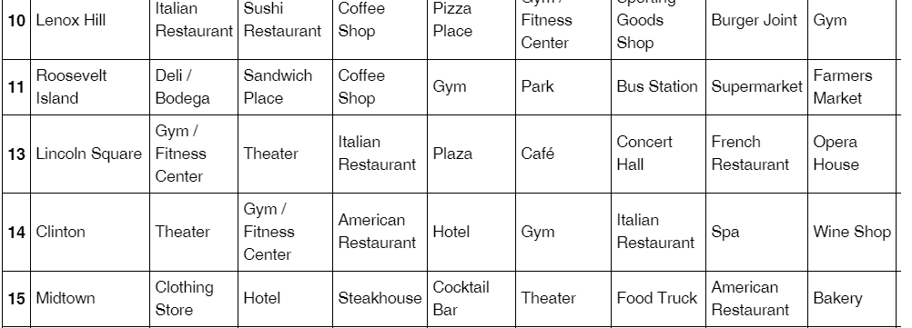
Results
Midtown neighborhood meets all FunX’s criteria:
Tour activities are organized in one neighborhood only
Venues for tour activities:
Places of interest, American restaurants, Bars and Shops

Slide 7
Conclusion
Based on FunX’s criteria, we will suggest to FunX the following itinerary.
FunX Tours Premium itinerary | Midtown
8am-9am | Breakfast - Coffee shop
9am-11am | Sight-seeing Midtown
11am-12pm | Shopping- Clothing store
12pm-2pm | Steakhouse
2pm-4pm | Shopping- Clothing store and bookstore
4pm-6pm | Spa
6pm-8pm | American restaurant
8pm-10pm | Theater
10pm-11pm | Cocktail bar
11pm- | Hotel

